Slide 1
The Divisions of the Nervous System
The Central Nervous System
The Peripheral Nervous System

Slide 2
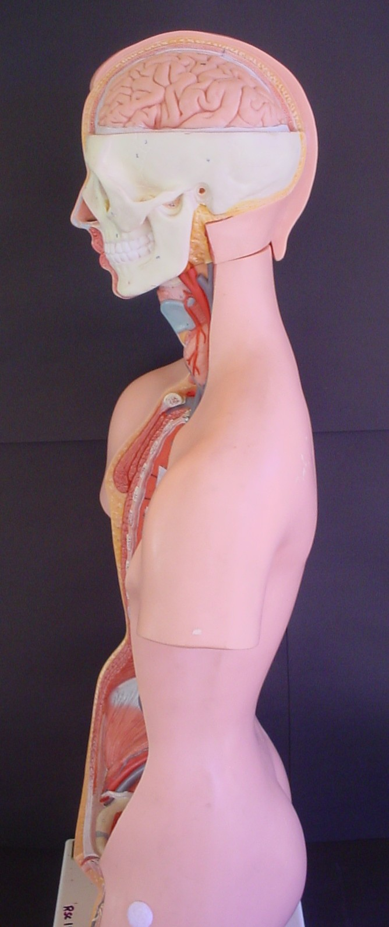
Central Division
brain
The nervous system is made up of the central nervous system (C.N.S)
C.N.S
spinal cord

Slide 3
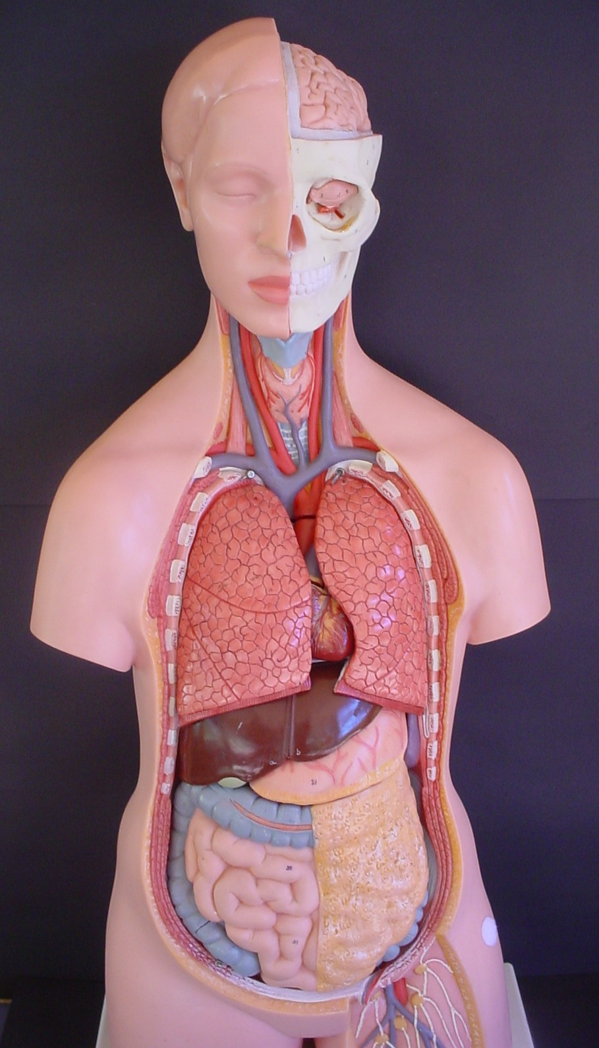
Peripheral Division
And the peripheral nervous system (P.N.S)
peripheral nervous system

Slide 4
Central & Peripheral Divisions
C.N.S
(brain and spinal cord
P.N.S
(peripheral nervous system)
right side of the body
P.N.S
(peripheral nervous system)
left side of the body

Slide 5
The pathway that nerve information takes is through the
Sensory (Afferent) Receptor S.A.R to the
Motor (Efferent) Effector M.E.E
The branches of the peripheral nervous
system (the left and the right side) contain
both afferent (sensory) and efferent (motor)
nerves called mixed nerves .

Slide 6
The relationship of the nervous system to the stimulus-response model
C.N.S
(brain and spinal cord
Modulator
Right side
AFFERENT DIVISION
(SAR)
Receptor
Afferent
Sensory
Right side
EFFERENT DIVISION
(MEE)
Motor
Efferent
Effector

Slide 7
Sensory (Afferent) Division
The afferent (sensory) division of the
nervous system picks up information and
sends this either to the brain or spinal cord
then the brain. This information is then
passed on to the efferent (motor) division to
elicit a response.

Slide 8
Movement of nerve impulses
C.N.S
(brain and spinal cord
Modulator
Right side
AFFERENT DIVISION
(SAR)
Receptor
Afferent
Sensory
Right side
EFFERENT DIVISION
(MEE)
Motor
Efferent
Effector

Slide 9
Sensory and Motor Sub-divisions
Further division occurs to help explain where
the information (the stimulus) is received
(the receptor sites – somatic or visceral) and
where the information goes (the effector
sites – the somatic or autonomic).

Slide 10
C.N.S
(brain and spinal cord
Modulator
AFFERENT DIVISION
(SAR)
Sensory
Afferent
Receptor
EFFERENT DIVISION
(MEE)
Motor
Efferent
Effector
SOMATIC DIVISION
(skin and skeletal muscles
VISCERAL DIVISION
(internal organs)
SOMATIC DIVISION
(skeletal muscles)
AUTONOMIC DIVISION
(flight or fight or “normal” response

Slide 11
The Sensory (Afferent) Nerves
Sensory information is picked up by receptors in the skin, skeletal muscles, internal organs such as the heart, the liver, the stomach and glands such as the thyroid gland) and is passed on to the brain.

Slide 12
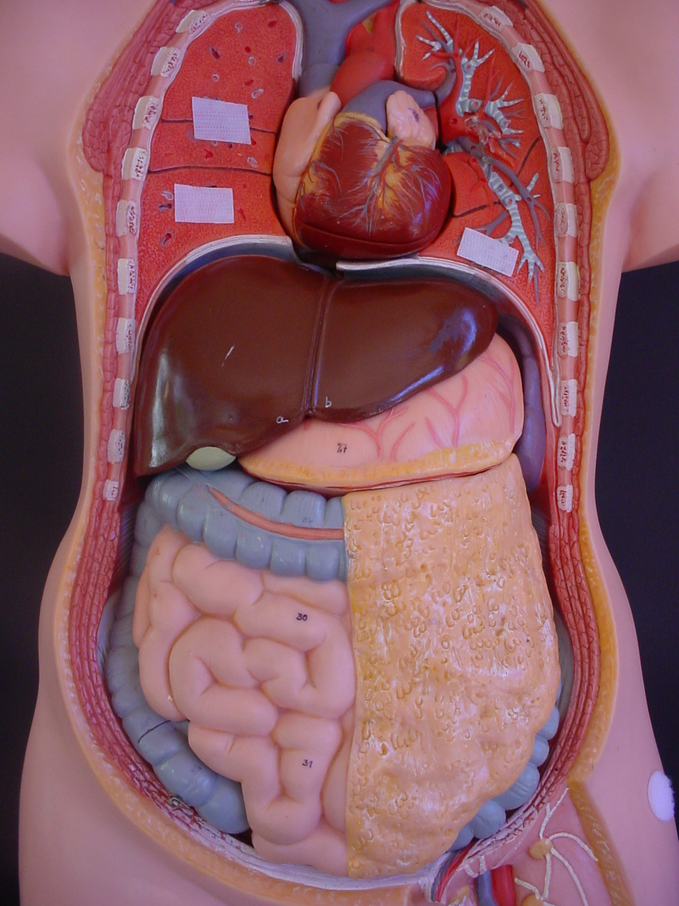
Sensory pathways towards the C.N.S
AFFERENT DIVISION
SOMATIC DIVISION
(skin muscles)
VISCERAL
(internal organs glands)

Slide 13
The Motor (Efferent) Division
The effector sites can send messages of a voluntary nature (somatic) to the muscles or in an involuntary way (autonomic) to the internal organs or glands .

Slide 14
Motor pathways away from the C.N.S
EFFERENT DIVISION
SOMATIC DIVISION
(skeletal muscles)
AUTONOMIC
(internal organs glands)

Slide 15
Movement of nerve impulses
C.N.S
(brain spinal cord
Modulator
AFFERENT DIVISION
(SAR)
Sensory
Afferent
Receptor
EFFERENT DIVISION
(MEE)
Motor
Efferent
Effector
SOMATIC DIVISION
(skin and skeletal muscles
VISCERAL DIVISION
(internal organs)
SOMATIC DIVISION
(skeletal muscles)
AUTONOMIC DIVISION
(flight or fight or “normal” response

Slide 16
The Autonomic Division
The autonomic nervous system carries impulses to the heart muscle, and other muscles of the internal organs and to the glands. It is responsible for the control of the body’s internal environment. It usually operates without conscious control and is regulated by groups of nerve cells in the, medulla oblongata, hypothalamus and cerebral cortex.

Slide 17
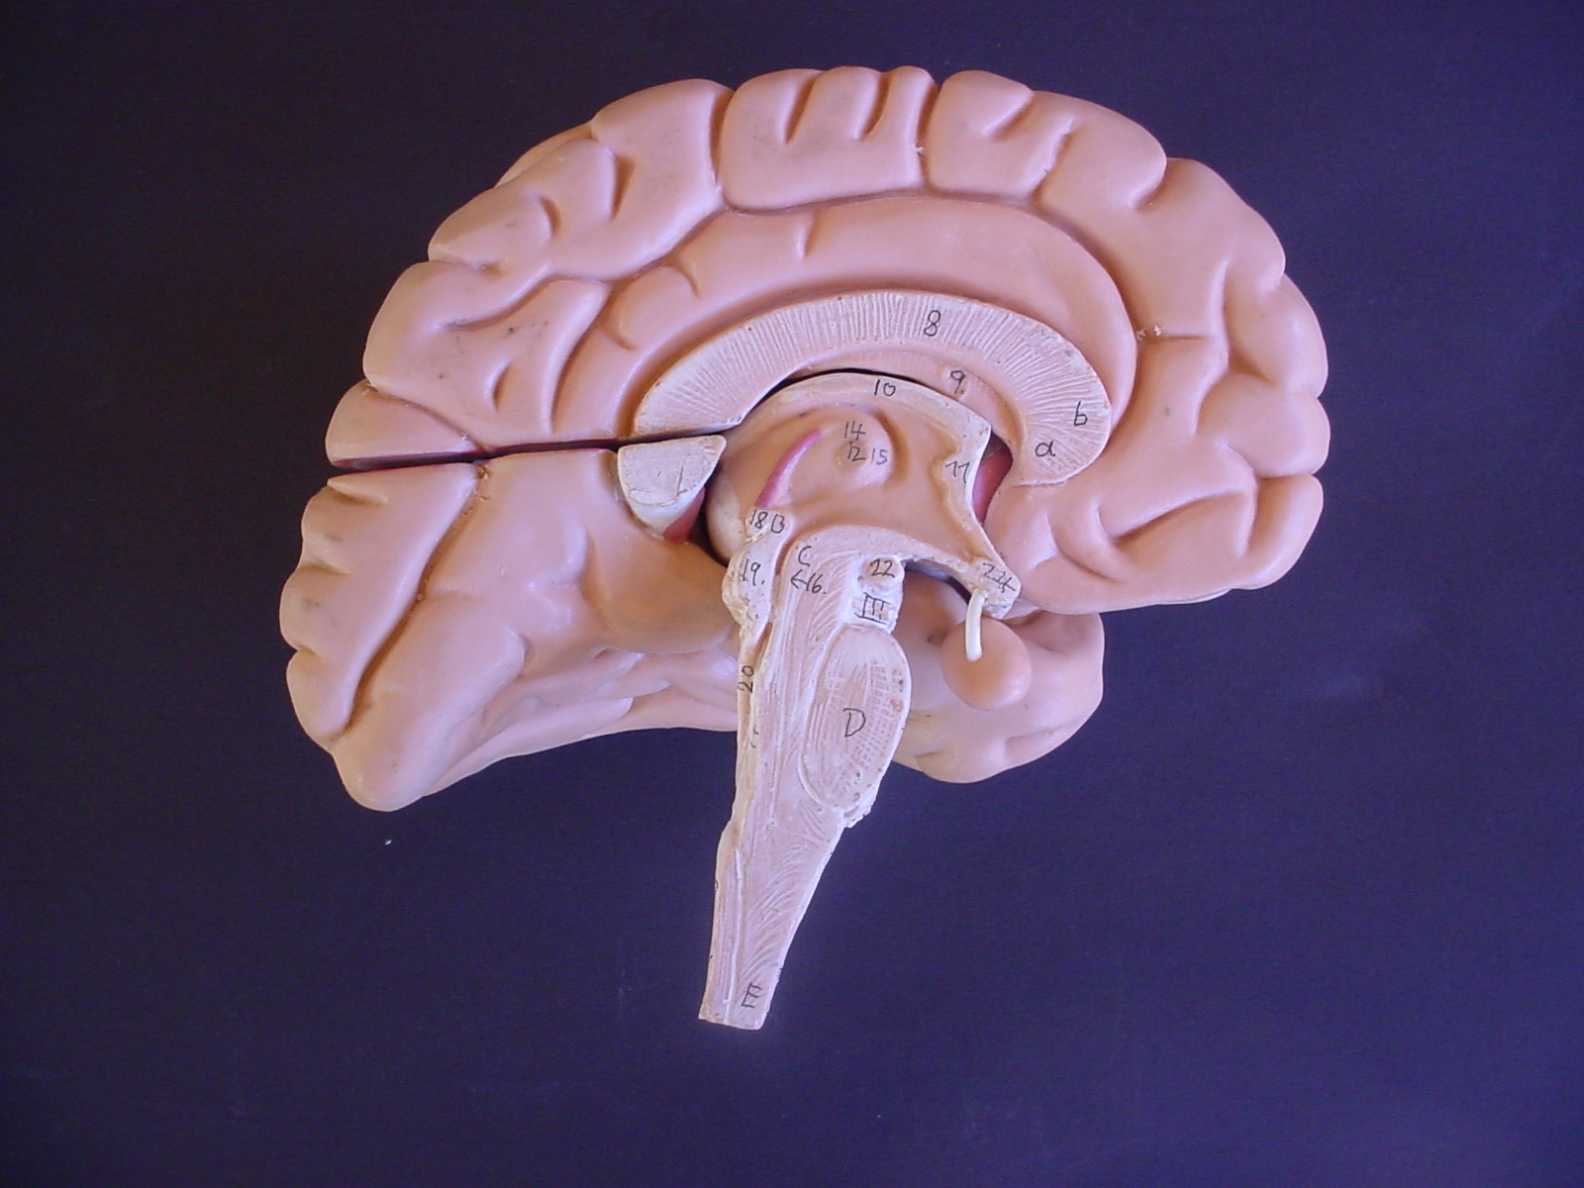
Regulation of the autonomic nervous system
Cerebral cortex
Medulla oblongata
hypothalamus

Slide 18
Sympathetic and Parasympathetic Nerves
Impulses from the parasympathetic and
sympathetic nerves have different effects
upon the organs and tissues.
Parasympathetic nerves maintain the body during relatively quiet conditions.
Sympathetic nerves produce responses that prepare the body for strenuous physical activity.

Slide 19
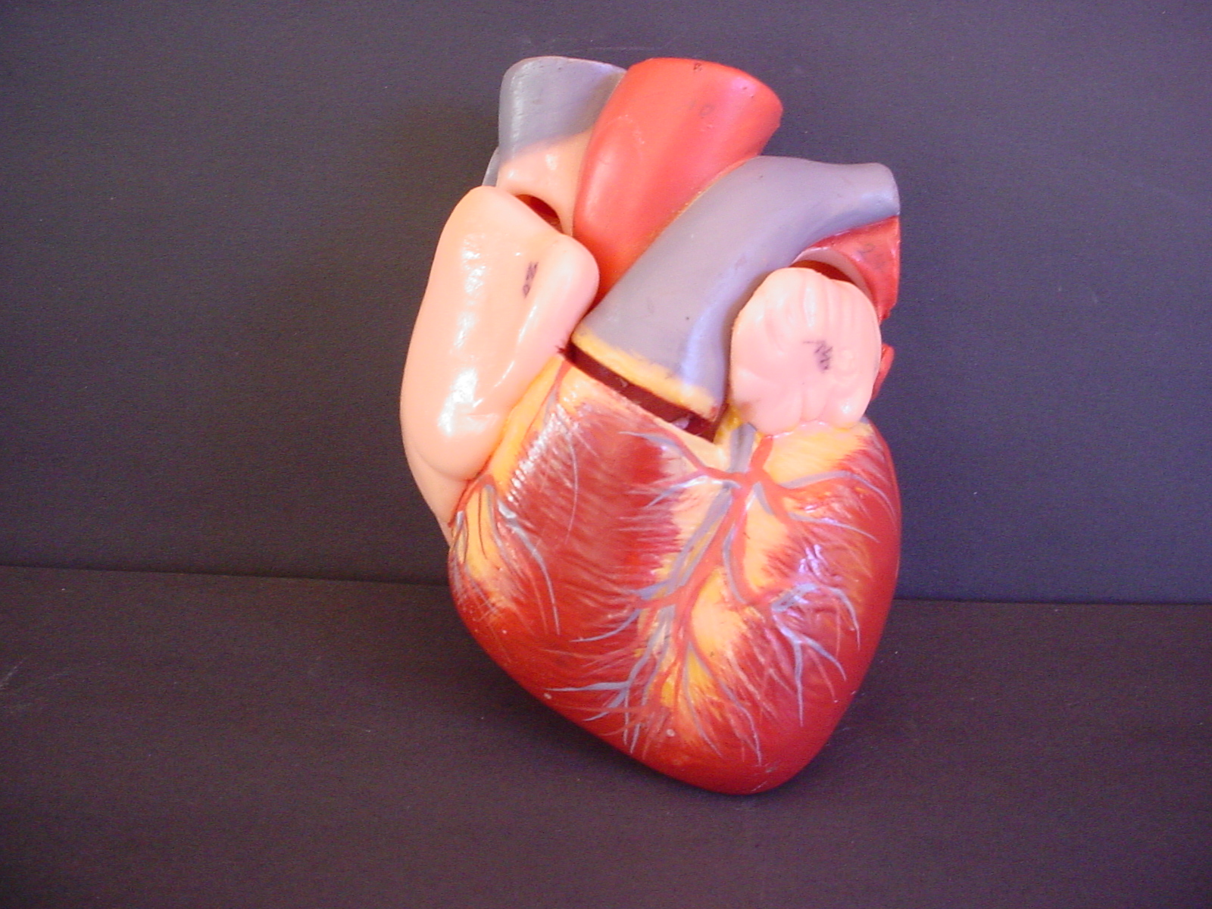
An Example of a Sympathetic-Parasympathetic Response
Autonomic
Sympathetic
Parasympathetic
The heart increases the rate and strength of contraction.
The heart decreases the rate and strength of contraction.

